Slide 1
History of Programming Language
In the 1940s the first recognizably modern, electrically powered computers were created. The limited speed and memory capacity forced programmers to write hand tuned assembly language programs. It was soon discovered that programming in assembly language required a great deal of intellectual effort and was error-prone.
Some important languages that were developed in this time period include:
1943 - Plankalkül (Konrad Zuse)
1943 - ENIAC coding system
1949 - C-10

Slide 2
History of Programming Language
In the 1950s the first three modern programming languages whose descendants are still in widespread use today were designed:
FORTRAN, the "FORmula TRANslator", invented by John W. Backus et al
LISP, the "LISt Processor", invented by John McCarthy et al.
COBOL, the COmmon Business Oriented Language, created by the Short Range Committee, heavily influenced by Grace Hopper.

Slide 3
History of Programming Language
The period from the late 1960s to the late 1970s brought a major flowering of programming languages. Most of the major language paradigms now in use were invented in this period:
Simula, invented in the late 1960s by Nygaard and Dahl as a superset of Algol 60, was the first language designed to support object-oriented programming. Smalltalk (mid 1970s) provided a complete ground-up design of an object-oriented language.
C, an early systems programming language, was developed by Dennis Ritchie and Ken Thompson at Bell Labs between 1969 and 1973.
Prolog, designed in 1972 by Colmerauer, Roussel, and Kowalski, was the first logic programming language.
ML built a polymorphic type system (invented by Robin Milner in 1978) on top of Lisp, pioneering statically typed functional programming languages.

Slide 4
History of Programming Language
The 1980s were years of relative consolidation. C++ combined object-oriented and systems programming. The United States government standardized Ada, a systems programming language intended for use by defense contractors. In Japan and elsewhere, vast sums were spent investigating so-called "fifth generation" languages that incorporated logic programming constructs.
Some important languages that were developed in this time period include:
1983 - Ada
1983 - C++
1985 - Eiffel
1987 - Perl
1989 - FL (Backus)

Slide 5
History of Programming Language
The rapid growth of the Internet in the mid-1990s was the next major historic event in programming languages. By opening up a radically new platform for computer systems, the Internet created an opportunity for new languages to be adopted.
Some important languages that were developed in this time period include:
1990 - Haskell
1990 - Python
1991 - Java
1993 - Ruby
1994 - PHP
2000 - C#

Slide 6
Programming Environment
Though Environment Setup is not an element of any Programming Language, it is the first step to be followed before setting on to write a program. When we say Environment Setup, it simply implies a base on top of which we can do our programming. Thus, we need to have the required software setup, i.e., installation on our PC which will be used to write computer programs, compile, and execute them.
We can write code in three ways:
A text editor to create computer programs.
A compiler to compile the programs into binary format.
An interpreter to execute the programs directly.

Slide 7
Text Editor
A text editor is a software that is used to write computer programs.
Some famous text editors are:
Notepad
Notepad++
Vim
Nano etc

Slide 8
Compiler
We can write our computer program using our favorite programming language and save it in a text file called the program file.But, the computer cannot understand the program directly given in the text format, so we need to convert this program in a binary format, which can be understood by the computer.
The conversion from text program to binary file is done by another software called Compiler and this process of conversion from text formatted program to binary format file is called program compilation. Finally, we can execute binary file to perform the programmed task.

Slide 9
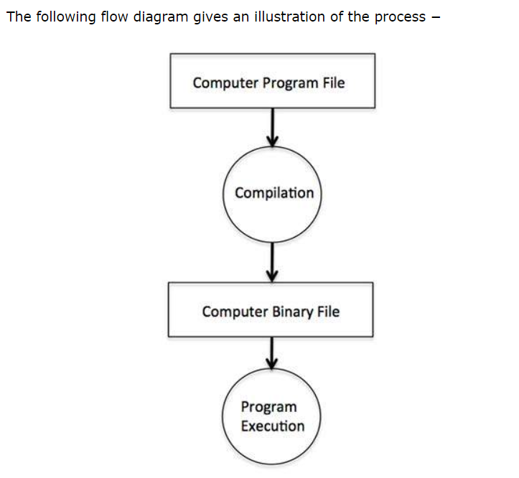
Compiler

Slide 10
Interpreter
We just discussed about compilers and the compilation process. Compilers are required in case you are going to write your program in a programming language that needs to be compiled into binary format before its execution.
There are other programming languages such as Python, PHP, and Perl, which do not need any compilation into binary format, rather an interpreter can be used to read such programs line by line and execute them directly without any further conversion.

Slide 11
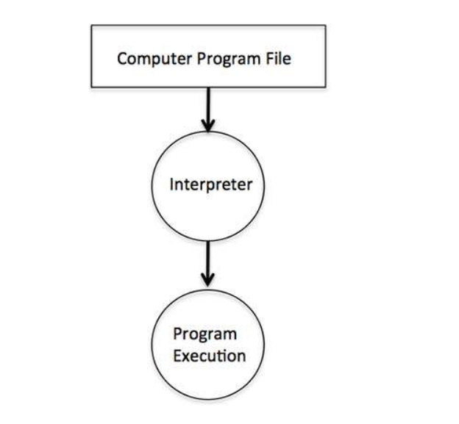
Interpreter

Slide 12
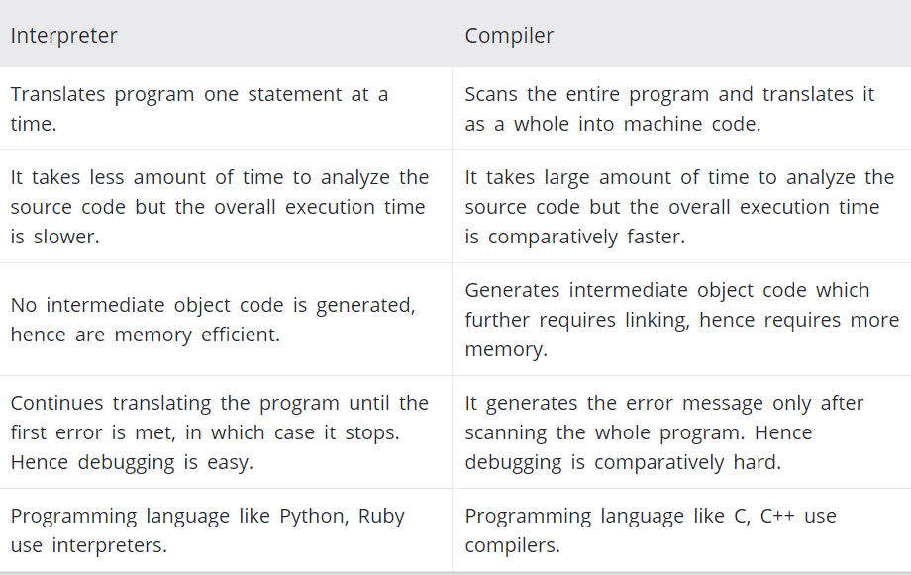
Difference Between Compiler and Interpreter

Slide 13
Structural Programming
Structural Programming is a technique for organizing and coding computer programs in which a hierarchy of modules is used, each having a single entry and a single exit point, and in which control is passed downward through the structure without unconditional branches to higher levels of the structure.
In structural Programming a program is broken into different sub-programs which is also called functions, subroutines, modules or procedures.
Structured programming minimized the chances of the function affecting another. It supported to write clearer programs.

Slide 14
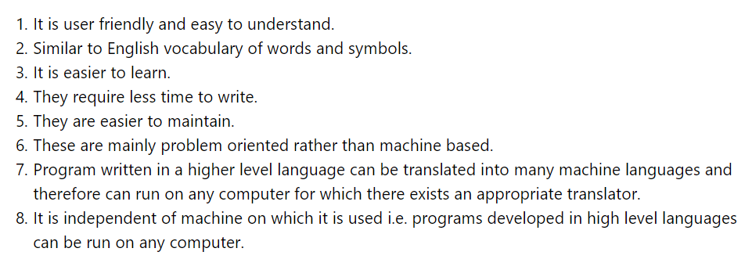
Advantage of Structural Programming

Slide 15
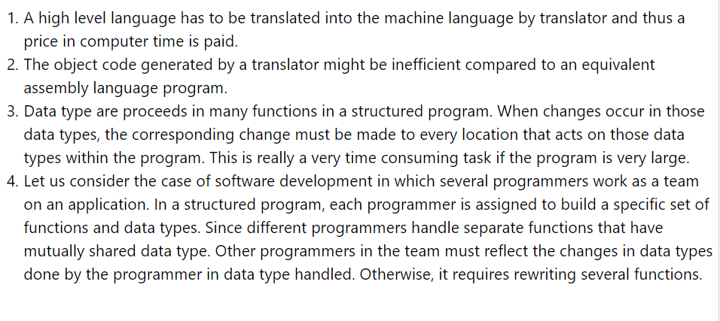
Disadvantage of Structural Programming

Slide 16
C programming Fundamentals
C programming language is a Structural Programming Language. We will use C programming language to see how Structural Programming language works.
A C program basically consists of the following parts −
Preprocessor Commands
Functions
Variables
Statements & Expressions
Comments

Slide 17
Tokens
A C program consists of various tokens and a token is either a keyword, an identifier, a constant, a string literal, or a symbol.
Example:
printf(“Hello world\n”);
Here tokens are: printf , ( , “Hello world\n” , ) and ;

Slide 18
Semiclone
In a C program, the semicolon is a statement terminator. That is, each individual statement must be ended with a semicolon. It indicates the end of one logical entity.
Example:
printf(“Welcome to IIT”);

Slide 19
Comments
Comments are like helping text in your C program and they are ignored by the compiler. They start with /* and terminate with the characters */ as shown below −
*/ This is my first comment.
This is a multi line comment*/
We can also write one line comment as shown below:
// This is a single line comment

Slide 20
Identifiers
A C identifier is a name used to identify a variable, function, or any other user-defined item. An identifier starts with a letter A to Z, a to z, or an underscore '_' followed by zero or more letters, underscores, and digits (0 to 9).
C does not allow punctuation characters such as @, $, and % within identifiers. C is a case-sensitive programming language. Thus, MyIdentifier and myidentifier are two different identifiers in C.

Slide 21
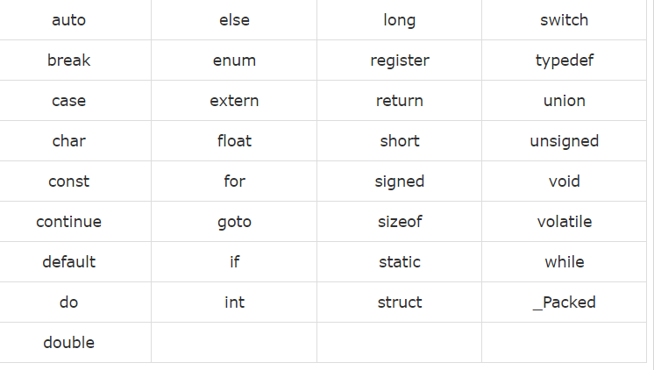
Keywords
The following list shows the reserved words in C. These reserved words may not be used as constants or variables or any other identifier names.

